Slide 1
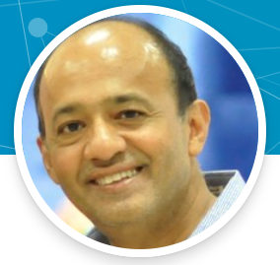


Robin Ghosh
Sr. Cloud Solution Architect
Robin.Ghosh@microsoft
https://github.com/RobinGhoshATL

Slide 2




Azure Messaging Services
Traditional enterprise broker message system
Think Reactive
programming
Traditional enterprise broker message system
Think Reactive
programming
Traditional enterprise broker message system
Multiple source big data streaming pipe
Multiple source big data streaming pipe
Storage Queues
Service Bus
Event Hubs
Event Grid
Simple task queues
Table Queues
Smallest payload
Enterprise messaging
Queues/Topics
Large payload
Streaming / Kafka
Conversational/fast paced (Medium payload) -- Replay/Partition
100K Batch limit
Cross cloud reactive eventing (Event Driven Architecture)
Small payload size(4K-5K) <=1M
5000 Batch Limit
Notes:
Messaging will go hand in hand when we develop/ These are our messaging offerings/ Event Grid is important. Azures own internal messaging/channelling is done using it..
We are fully Event Driven Architecture complaint. Event Grid is backed by Azure’s own SLA
Something has happened --- Event Hub
Do something OR GIVE ME SOMETHING – Service Bus

Slide 3
Where are customers coming from ?
IBM MQ
Apache-Active MQ
Rabbit MQ
Oracle/ Weblogic & TIBCO
What are they bringing ? [Integration Work Flow]
Storage Queues
Service Bus
Event Hubs
Event Grid
Brokered client code (Java & .NET)
Server code (Listener/Consumer)
-- Java Standard command line
-- .NET Windows Service
-- Java/Spring (Maybe JMS)
Simple task queues
Table Queues
Smallest payload
Streaming / Kafka
Conversational/fast paced (Medium payload) -- Replay/Partition
Cross cloud reactive eventing (Event Driven Architecture)
Small payload size(4K-5K) <=1M
5000 Batch Limit
Enterprise messaging
Queues/Topics
Large payload
Notes:
Messaging will go hand in hand when we develop/ These are our messaging offerings/ Event Grid is important. Azures own internal messaging/channelling is done using it..
We are fully Event Driven Architecture complaint. Event Grid is backed by Azure’s own SLA
Something has happened --- Event Hub
Do something OR GIVE ME SOMETHING – Service Bus

Slide 4
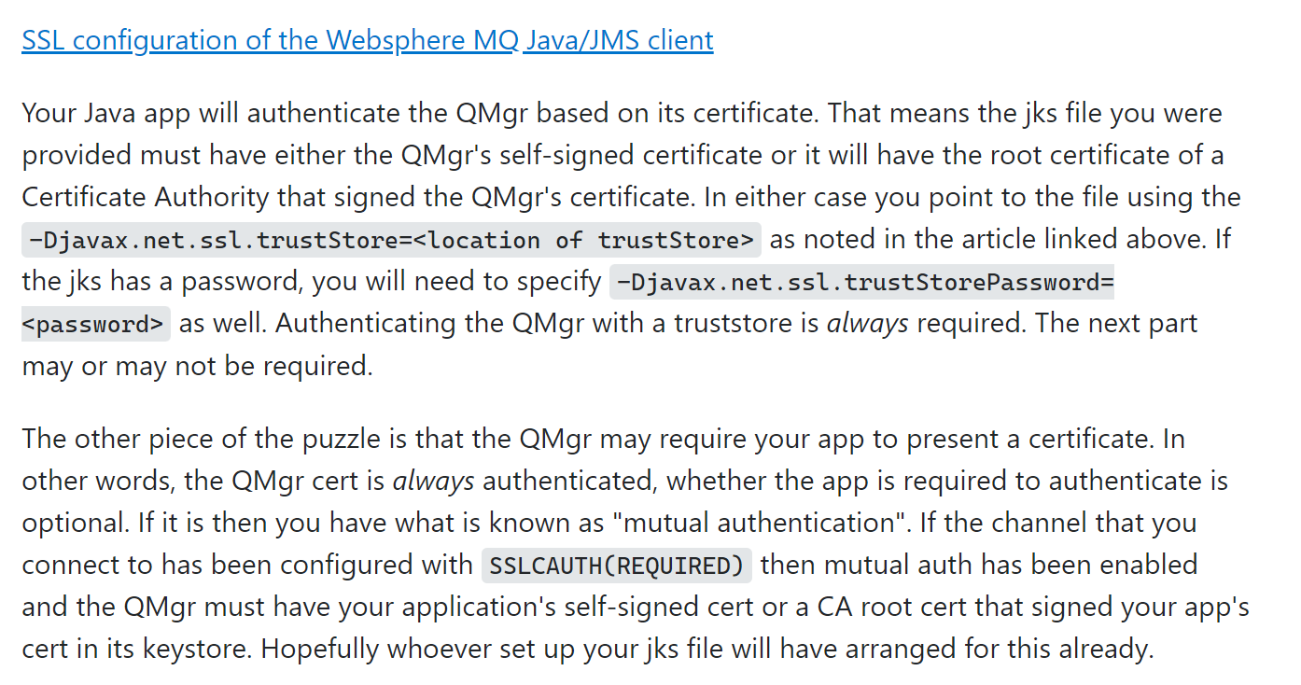
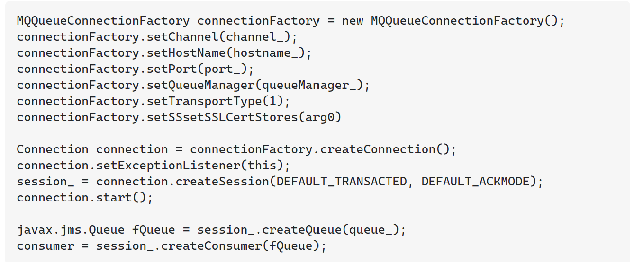
How to help? Understand First: What they bringing Check:-Code might use SSL – so Transform Remove: - Interact with any Azure Services - Interact with any databases using external libraries) - Interact with other API’s - Bring in existing business logic and embed as methods

Slide 5
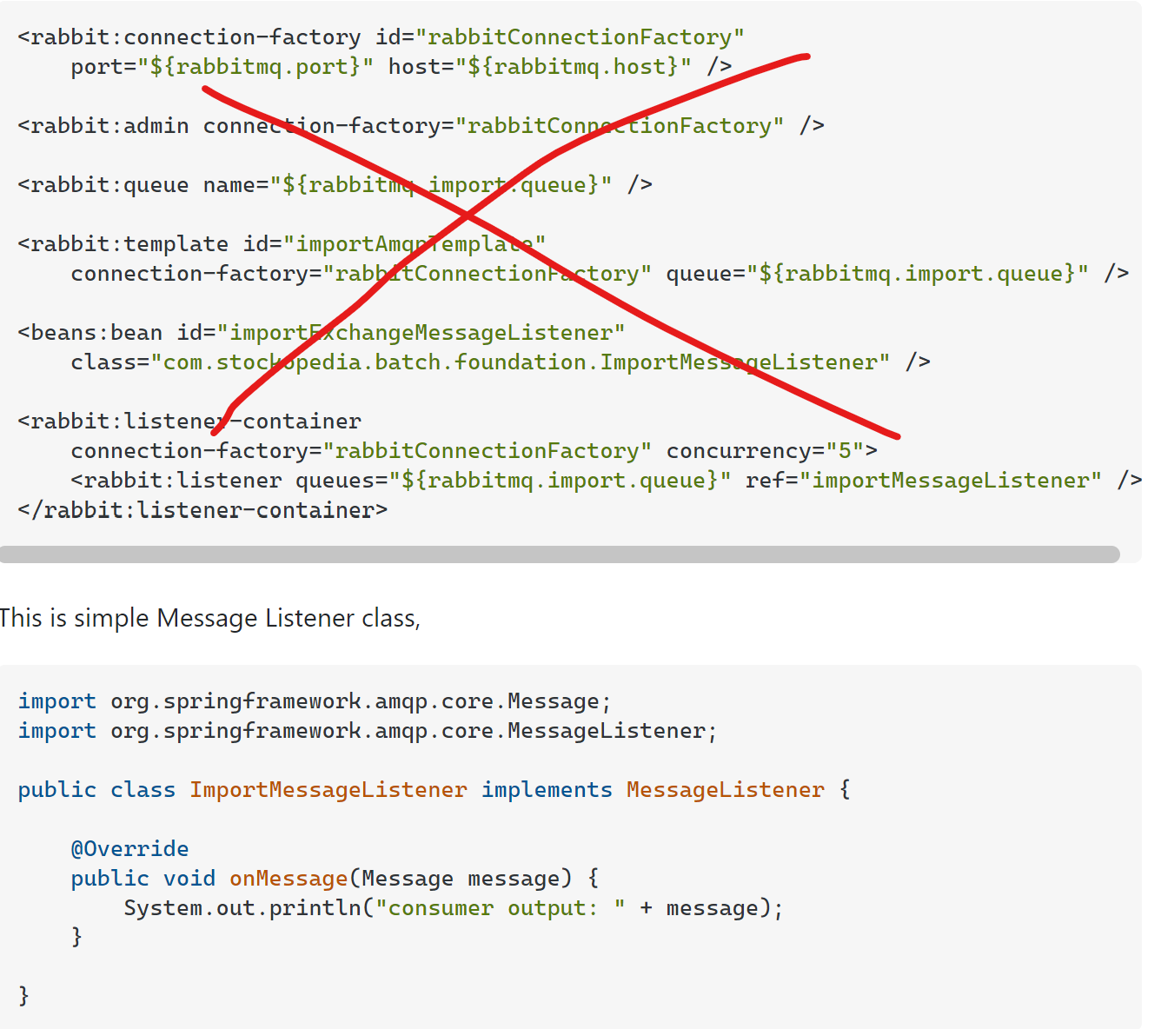
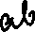

How to help? Remove:

Slide 6
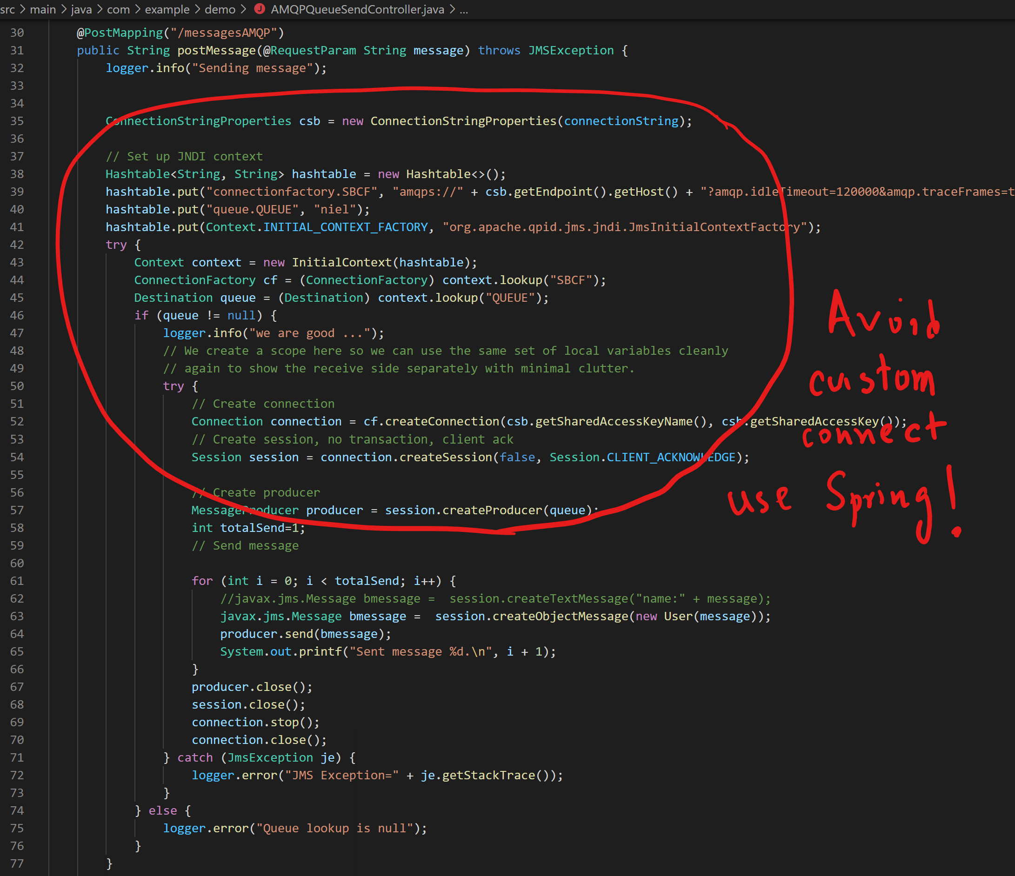
Avoid boiler plate code/So ask to refactor

Slide 7
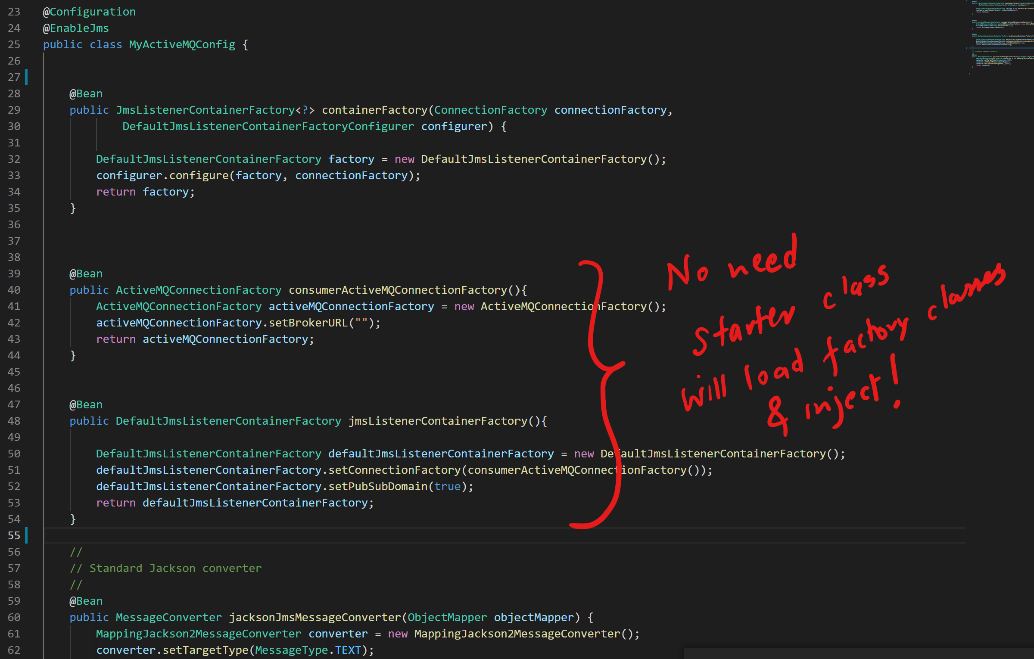
Avoid boiler plate code/So ask to refactor

Slide 8
How to help? Look/Adjust: - External Configs, custom classes without frameworks Hold them/Work with them : - Turn their standalone programs into a true service Maybe Azure Serverless?

Slide 9
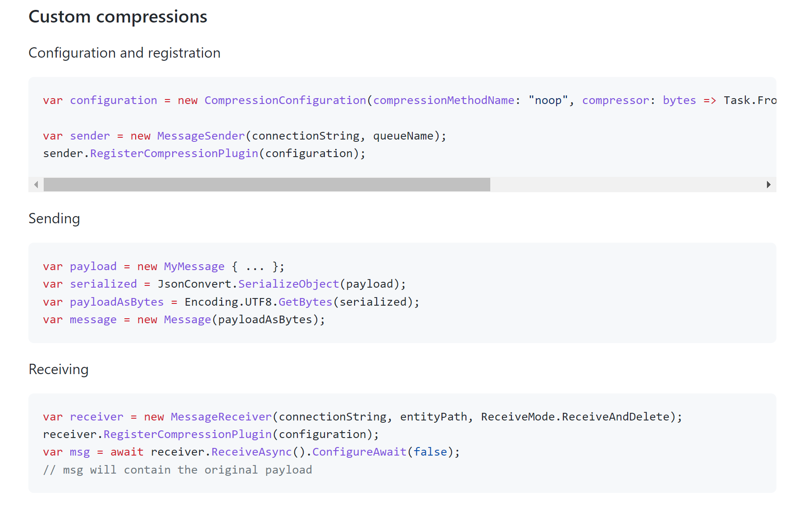
Need help on? Compression: Is it in the engine or not? SeanFeldman/ServiceBus.CompressionPlugin: Azure Service Bus Compression Plugin (github.com)

Slide 10
Need help on? DLQ - No reprocessing support like Rabbit-MQ Customer is deferring the message before completion ....and then completing it which is wrong ActiveMQ and JMS have "reply-to" functionality - where the sender indicates on send the queue name where it wants to see responses come back to - and the consumer complies with that. The reply-to queue can be fixed or a temporary one that the sender creates up-front.

Slide 11
Customer –OneTrust ask: Love to migrate to Azure across our entire Enterprise Integration tier, but need the jar deployments to switch between Active MQ and AService Bus using a runtime switch. We have several customers across the globe and we believe in phased cut-over and without this feature will drop migrating to Azure Cloud Allow customer to switch code (jar executable) between Service Bus and Active MQ product for a phased cut over production approach. spring.jms.servicebus.enabled=true/false to read between Active MQ Queues or Service Bus Queues [NOT WORKING for 3.10 and 3.13 releases]

Slide 12
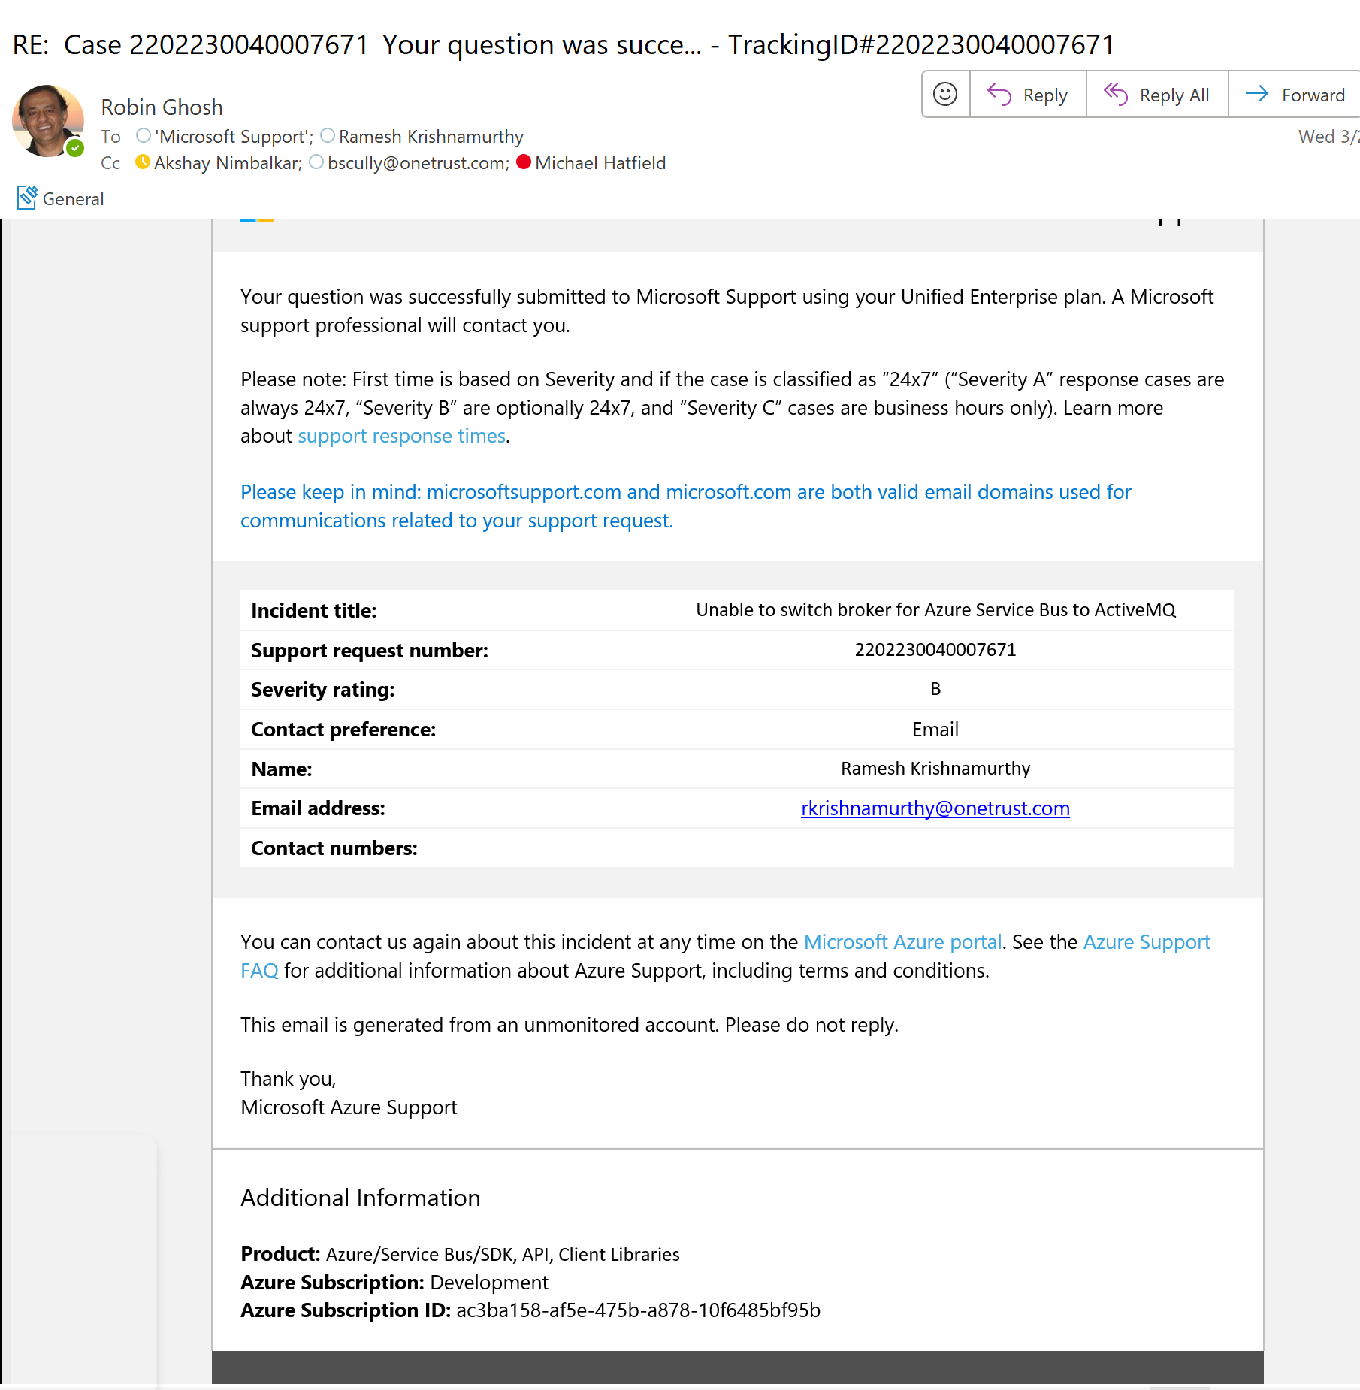
Customer Ticket:

Slide 13
Demo:

